Slide 1


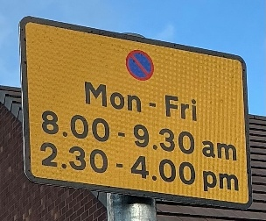



BURLEYFIELDS
BULLETIN
WEEK BEGINNING 5th January
Spotlight on our learning
Attendance
This week we have welcomed back our children in Reception and Nursery whilst also welcoming lots of new starters in Nursery. Welcome to Burleyfields!
Despite the snow we have managed to enjoy learning in all weathers with the children having hands on experience of the winter season. Thank you for supporting us with this by dressing your children in suitable clothing for the cold weather.
This week our Reception children have listened to and performed the poem ‘Take Off Your Brave’. Our Preschool children have enjoyed the story The Snowflake and our two-year-olds have read Happy New Year, Spot. All our children have learnt about the celebration of New Year.
Just a final reminder that admissions for Reception places close on January 15th. If you haven’t yet applied, then please do so using the link below. If you have any difficulties accessing the form, then please speak to Mrs Sephton in the office.
Admission to primary and middle schools - Staffordshire County Council
Have a lovely weekend,
Mrs Thorley
At lunchtimes, our whole school attendance is 89.4%.
Parking Restrictions
There are now parking restrictions in place on the single yellow lines outside of school. There is no waiting Monday – Friday
8.00 – 9.30am & 2.30 – 4.00pm. As always, we please ask that you park respectfully of our neighbours and do not block drives. Thank you for your understanding.
What’s Coming Up
Thursday 22nd and Friday 23rd January – Grandparents Lunch.
More information will follow.

